Slide 1

Bike sharing in Seoul
Nicolas BONNET
DIA3

Slide 2

Topic
Currently Rental bikes are introduced in many urban cities for the enhancement of mobility comfort. It is important to make the rental bike available and accessible to the public at the right time as it lessens the waiting time. Eventually, providing the city with a stable supply of rental bikes becomes a major concern. The crucial part is the prediction of bike count required at each hour for the stable supply of rental bikes.
The dataset contains weather information (Temperature, Humidity, Windspeed, Visibility, Dewpoint, Solar radiation, Snowfall, Rainfall), the number of bikes rented per hour and date information.

Slide 3

Dataset composition

Slide 4
General composition
Shape : 8760 rows & 14 columns
Features : 10 float & 4 categorical
No NaN
No empty columns/rows

Slide 5
Attribute information
Date : year-month-day
Rented Bike count - Count of bikes rented at each hour
Hour - Hour of the day
Temperature-Temperature in Celsius
Humidity - %
Windspeed - m/s
Visibility - 10m
Dew point temperature - Celsius
Solar radiation - MJ/m2
Rainfall - mm
Snowfall - cm
Seasons - Winter, Spring, Summer, Autumn
Holiday - Holiday/No holiday
Functional Day - NoFunc(Non-Functional Hours), Fun(Functional hours)

Slide 6
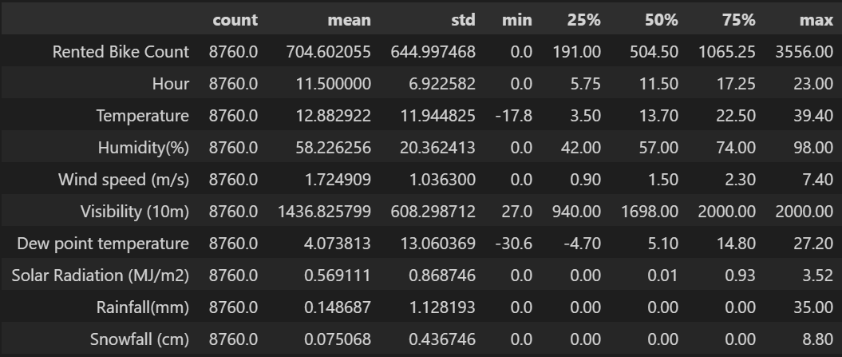
General idea of data
Thanks to the data.describe().T function, we can pin up a general idea of the dataset. Thus, we can scale each parameters by knowing the mean, min or max value.
We can also know if values are missing or wrong.
This is an important phase to prepare data in order to execute visualization and modeling

Slide 7
Data preparation

Slide 8
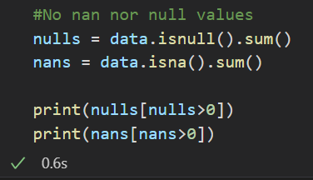
Verification of NaN values
We have to check if all parameters and information are coherent. In order to manipulate data the best way, we check the NaN (Not a Number) or Null values. Those are all the values that could be wrong in the dataset and that could distort our work.

Slide 9
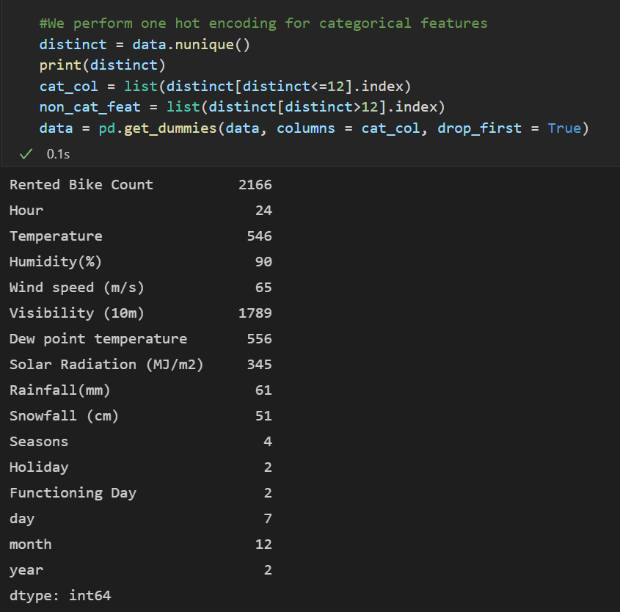
We perform One Hot Encoding…
This helps us to manipulate data. It creates new distinct columns for each parameter that has less than 12 values. We can therefore compare data according to seasons or month for example.

Slide 10
…to create more valuable parameters
Thus, we have created several parameters to use them in our models.
This parameters give us a better visualisation and exploitation of the dataset. This is due to a better separation of the information that are in the dataset.
For example, we separated the seasons or the weekday, which is more relevant than a comparison by month.

Slide 11
Data visualisation

Slide 12
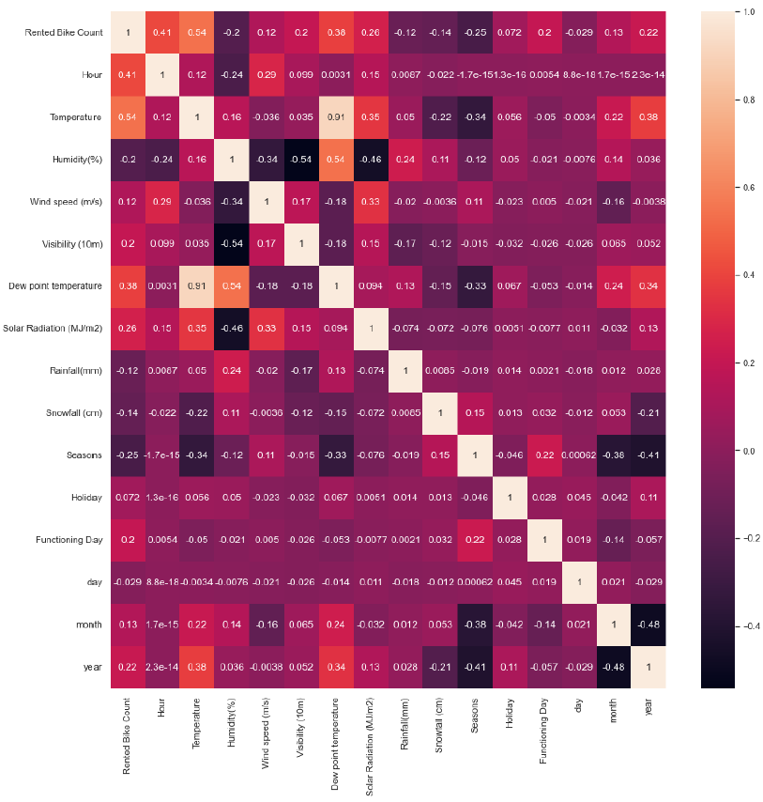
Correlation Matrix
The more the correlation number is close to 1, the more correlated is the Rented Bike Count to the Parameter.
For example, here, we can see that the number of bikes rented is highly correlated to the temperature, the hour or the dew point temperature.

Slide 13
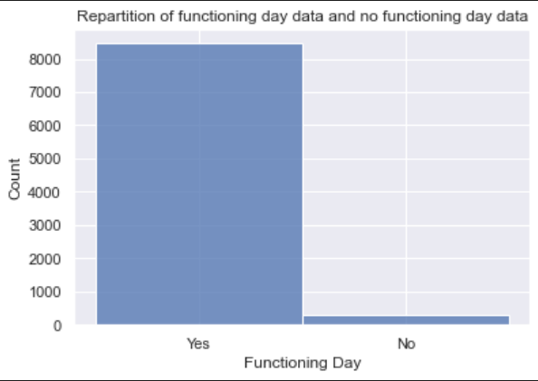
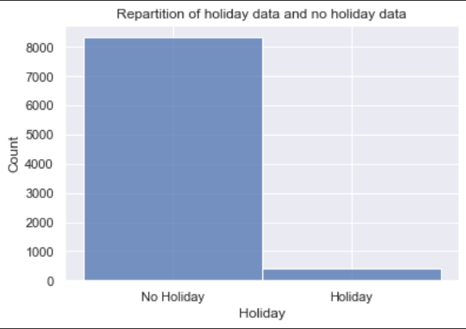
Repartition Functioning/Holiday Day data
This shows us that we have to be careful because the model will learn more on the periods out of holidays and will be maybe less precise on vacations

Slide 14
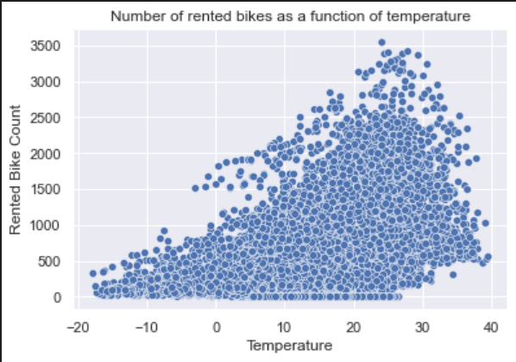
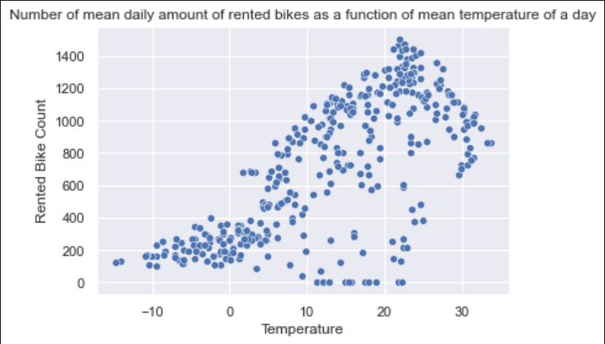
Rented Bike Count Visualisation

Slide 15
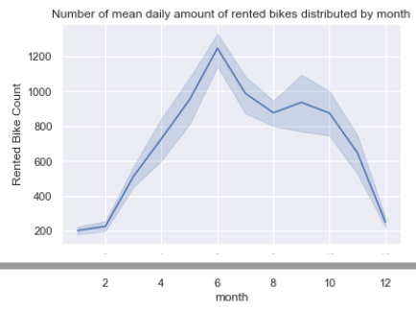
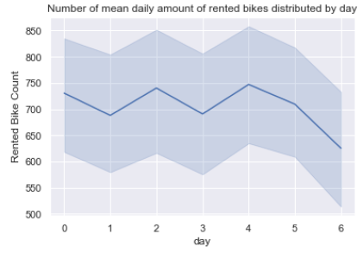
Rented Bike Count Visualisation

Slide 16
Data modeling

Slide 17
Search for the best model
We scale data
We prepare date for future Regression
We perform a grid search to search for the best model and best hyper parameters

Slide 18
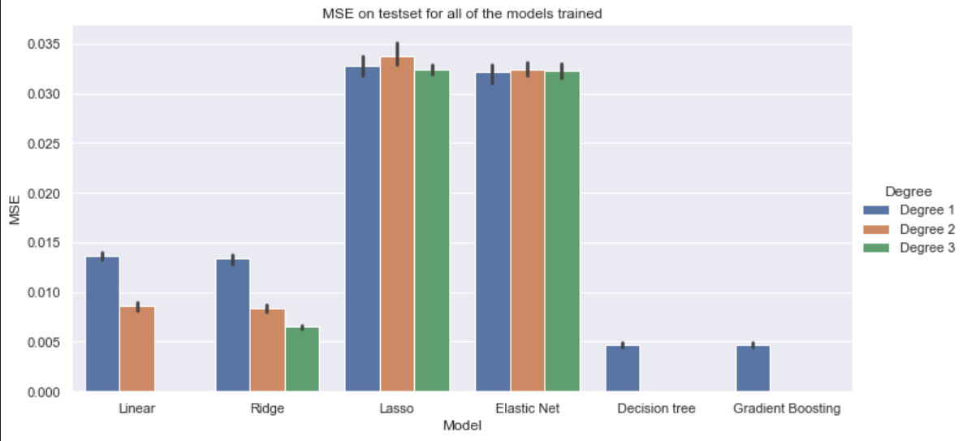
Visualisation of the best model

Slide 19
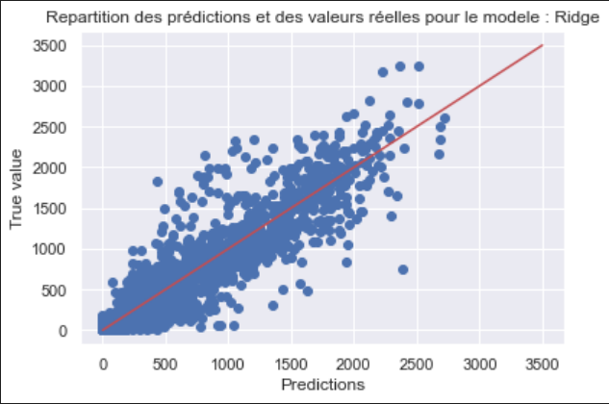
We study more in depth each model
Ridge Model
MAE : 186.22029
MSE : 77083.25

Slide 20
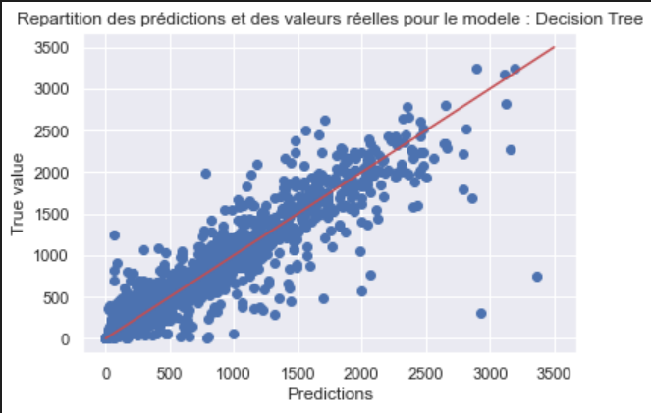
Decision Tree
MAE : 129.98744…
MSE : 54158.654065…

Slide 21
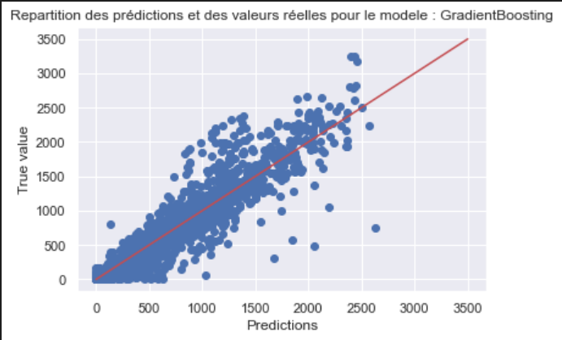
Gradient Boosting
MAE : 158.185571…
MSE : 58809.840246…

Slide 22
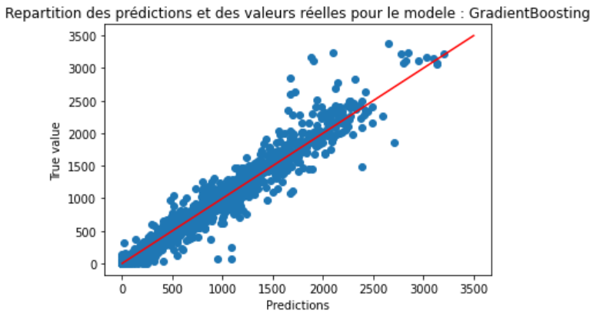
Bonus : We test a real time prediction
We add a column with the number of bikes rented during the last hour. The company might not always have this information, but this could lead to a strategy of live gestion of bikes in the city.
MAE : 91.39186990…
MSE : 23484.216761…

